Slide 1

CEE Partner Readiness series June edition Go-To-Market update

Slide 2
Today we will talk about
How we drive Go-To-Market with you
Programs that will help your business
Modern Work
Business Applications
Azure
In case you see this is valuable for you, please:
Add your feedback / comment / topic you would like to hear about in IM
Access recording and deck on aka.ms/AA8t54z
Subscribe to our monthly communication here: aka.ms/AA8t56p

Slide 3
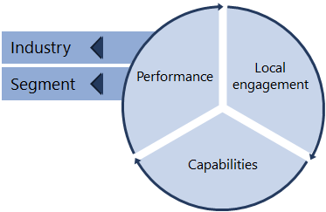
How do we work with partners?
Solution Area priorities & Sales Plays
Incentives & Investments
Partner alignment
Partner selection
Partner execution
Aligning partner capabilities to plays
Focus with partners on Co-Sell solutions
Orchestrated execution
Customer value delivered via pre-defined Solution Area Sales Plays
and Industry Priority Scenarios
Quality objective criteria validation
Alignment across Microsoft sales team
Sell-With motion
Sales execution: shared engagements/opptys with Co-Sell partners
Solution Area
Modern Work
Business Applications
Azure
Services
Applications
GTM motion
Opportunity generation via Play execution: shared engagements/opptys through Co-Sell partners
Global ISV
IPS
Vertical
Industry
ISV connect premium
CEE ISV
Industry
Financial Services
Manufacturing
Retail
Media & Communications
Government
Healthcare
Education
Build-With motion
Modernization with partners
Recruit
#1 Prioritize recruitment of practice/solution gaps with partners
#2 Strategically recruit new partners
Recruit
Identification of gaps across technical capabilities, customer segment or industry

Slide 4
What are the solutions we would like to work with you on?
 |  | PRIORITIES | SALES PLAYS
Modern Work & Security | Microsoft 365 Surface Security | Enable Secure Remote Work | 1) Teams Meetings & Calling
 |  |  | 2) Secure Remote Work (Identity, Cloud Management, Protection)
 |  |  | Surface & Partner Devices
 |  | Reduce Cost and Manage Risk | 3) Security (Integrated Threat Protection including MTP + ASC + Sentinel)
 |  |  | 4) Compliance (Insider Risk Management, Info Protection & Governance)
 |  |  | Teams Meetings & Calling
 |  | Transform Organizational Productivity | 5) Surface & Partner Devices
 |  |  | 6) Teams Platform
 |  |  | 7) Firstline Workers
 |  |  | 8) Knowledge & Insights
Apps & Infra Data & AI | Azure | Migrate existing applications to Azure and optimize | 9) Windows Server & SQL Server on Azure
 |  |  | 10) Linux and OSS DBs on Azure
 |  |  | 11) SAP on Azure
 |  |  | 12) Windows Virtual Desktop (WVD)
 |  |  | 13) Hybrid Cloud Solutions
 |  | Innovate with new apps and modernize existing apps | 14) Analytics & AI
 |  |  | 15) Modernize .Net Apps with App Service, Azure SQL DB
 |  |  | 16) Cloud Native apps with AI, Kubernetes, Azure Cosmos DB / PostgreSQL
 |  | Enable customers for successful cloud use | 17) Developer engagement
 |  |  | 18) DevOps with GitHub
 |  | Deliver unique, specialized solutions, focusing on Enterprise customers | Applications: 19) IoT, 20) MR, 21) Gaming
 |  |  | Infrastructure: 22) Azure VMware Solutions, 23) HPC, 24) Advanced Networking
Business Applications | Dynamics 365 Power Platform | Stay Connected with Customers | 25) Activate Digital Selling
 |  |  | 26) Enable Always-On Service
 |  | Run Adaptive Business Operations | 27) Build a Resilient Supply Chain
 |  |  | 28) Manage Financial Risk and Reduce Fraud
 |  | Rapidly adapt and automate business processes | 29) Build Agile Business Processes
 |  |  | 30) Generate Value with Proactive Insights

Slide 5
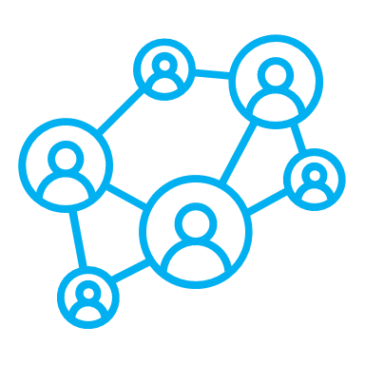
Modern Work Szabolcs Lippé

Slide 6


FY21 Objectives, Priorities and Sales Plays
 | Business Objectives | Priorities | Sales Plays
 | Grow Usage Grow usage of Teams, Identity, and establish customer health across Microsoft 365 Increase Premium Mix Upsell to Microsoft 365 suites and E5 by helping customers consolidate vendors and save cost Drive Seats and Devices Increase users, Firstline workers and Surface | Secure Remote Work | Teams Meetings & Calling Surface and Partner Devices Security
 |  | Reduce Cost and Manage Risk | Security Teams Meetings & Calling Compliance
 |  | Transform Organization Productivity | Teams Platform Firstline Worker Knowledge and Insights Surface and Partner Devices

Slide 7
FY21 Modern Work GTM strategy
 | 1:many GTM activities | 1:1 GTM activities
Customers to target | Midmarket customers (20+ seats) | Big customers (100+, 300+, 1000+ seats)
Partner requirement | CSP Direct or Indirect Provider | Cosell Ready MW or Fasttrack MW partners
Delivery format | All type of Marketing activities | Only 1:1 using the official content
Content to use | Teamwork/Security/Adoption | Teamwork/Security/Adoption assessments
Goal | Generate 0-20% leads and opportunities | Generate 20% BANT qualified opportunities
Start date | July 2020 | July 2020

Slide 8
Partner readiness
Digital Hybrid Learning Workshops
Executed with Learning Partners to increase the number of MCP certifications,
Focus on prioritized advanced Security and Teamwork certifications.
L300+ Deep Tech Trainings for managed partners and managed Distributors
Focus on Security, Teams Meetings & Calling and Power Platform.
3days-5days trainings delivered by experts
SMB Fundamentals + M365 Workshops
Continued online enablement in Q1 and Q2, executed by Indirect Providers to resellers,
Focusing on Teams and Security.
Adoption and Change Management workshops
Continuing our Prosci certification workshops to support partners focusing on corporate and enterprise accounts
Resources supporting the delivery of the 1:1 assessments
Train the trainer materials and the assessment itself
Other resources available
M365 For Partner Technical Readiness​
M365 For Partners Sales Readiness

Slide 9
Next steps (on top of doing the readiness)
If you are a
CSP Direct or Indirect provider | Contact you Partner Development Manager and start a conversation about a possible midmarket campaign
CSP reseller | Contact your Indirect Provider (Distributor) and join to the lead generation campaign as reseller
Cosell Ready/Fasttrack ready Partner with big Corporate and Enterprise customer base | Contact your Partner Development Manager or/and visit the Cloud Accelerator portal and nominate(from July) customers
Registered MPN Partner with no MW competency or Cosell ready status | Use the readiness materials and build competency, get the cosell ready status and join to the campaign ☺

Slide 10
Business Applications Peter Kuna

Slide 11
Microsoft Fiscal Year 2021 priorities – Business Applications
Partner investment and execution strategy
Leverage Dynamics 365 Migration Program (DMP) to execute assessment, POC and migrations
Improve partner capability through upskilling in all Dynamics and Power Platform workloads
Expand existing practices with Customer Insights & Power Apps
Enrich partner portfolio with new ISV Connect partners
Sales Play | Underlying products
Enable Always on Service | Dynamics 365 for Customer Service Portals Omnichannel for Customer Service Power Virtual Agent
Build a Resilient Supply chain | Dynamics 365 for Finance Dynamics 365 SCM Dynamics 365 Business Central
Generate Value with Proactive Insights | Dynamics 365 Customer Insights
Activate Digital Selling | Dynamics 365 for Sales LinkedIn Sales Navigator
Manage Financial Risk and Fraud | Dynamics 365 Commerce Dynamics 365 Fraud Protection
Build Agile Business Processes | Power Automate Power Apps Power BI

Slide 12
Learning options for you
1
Description
1, Microsoft Baseline Events – local (digital) aimed at giving introductory information about the Business Apps portfolio. Expect broad communication from Microsoft Marketing team.
2, Exam Preparation sessions – (local) limited space organized by local enablement leads. Stay tuned on the regular forums where your local team promotes partner skilling events!
3, Catalyst, Sales and Customer Success Trainings – (CEE Area) If you require further information you can reach out to Peter Kuna about the motion.
4, VILT (Virtual Instructor Led Courses) – Corp driven Online training offerings to be fount on partner.Microsoft.com. Link
5, Technical 1-1 engagements (solution development/ practice building)
- Unmanaged partners – Engage PTC community through “Technical Presales and Deployment services” (Link)
- Managed Partners – request Architect support through your Partner Development Manager.
Terms and conditions apply, you need to discuss with your local Microsoft representative to determine eligibility, and the right program for you.

Slide 13
Through Partner Activities and “in-a-day” offers
1
Description
Through partner investment activities aim at selecting a set of customers together with Microsoft segment team and delivering interesting content to them at different stages of the sales journey that open new discussions or show value with Dynamics 365 cloud or Power Platform.
In scope of the available programs are
opportunity generating workshops (Catalyst Envisioning),
in a day event deliveries,
Proof Of Concept (POC) offers,
Deployment/consumption offers.
Minimum requirement for enrollment is:
“co-sell ready” offer available on AppSource (Work with your PDM or CED to get this status)
Alignment with the local team on select customers and what to deliver (both brought by you and Microsoft)
A nomination (and acceptance) to the program – available through the local team
The program applies for all Microsoft sales plays but there may be differences in the required documentation and how to apply.
Terms and conditions apply, you need to discuss with your local Microsoft representative to determine eligibility, and the right program for you.

Slide 14
Power Platform Partner Program
1
Description
Get access to an exclusive partner portal, community, and resources to kick-start becoming a Power Apps partner. Gain exposure by listing your organization on PowerApps.com as a preferred partner.
Get early access to free webinars and training workshops
Showcase app building skills by letting customers test drive your apps.
Run Microsoft co-branded marketing events to receive high quality leads for your services pipeline. Receive invitations for private previews from Engineering.
Get targeted leads and pre-sales support for strategic campaigns.
Publish your Power Apps consulting services offers in AppSource
https://aka.ms/PowerAppsPartner
Terms and conditions apply, you need to discuss with your local Microsoft representative to determine eligibility, and the right program for you.

Slide 15
Dynamics Migration Program
1
Description
Customers can request a free assessment from Microsoft through certified assessment partners to start them on their cloud journey.
Microsoft team will reach out proactively to end of support customers to enroll them in the program.
Customers with End of Support products have a great opportunity to join the Cloud world (Migration license offers and deployment funding is available in case we manage to identify a good path to cloud.
The program is a collaboration between Microsoft – You – and a migration assessment partner
https://dynamics.microsoft.com/en-us/migration-program/
Terms and conditions apply, you need to discuss with your local Microsoft representative to determine eligibility, and the right program for you.

Slide 16
Azure Applications, Infrastructure, Data, AI Tomas Pavlu

Slide 17

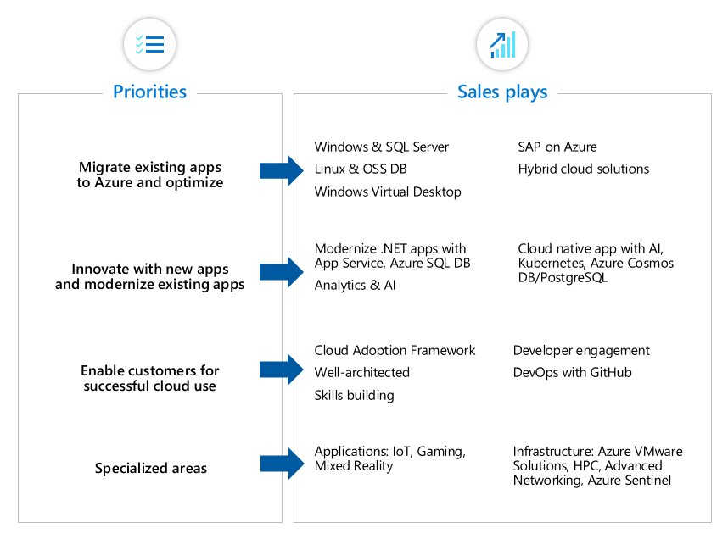
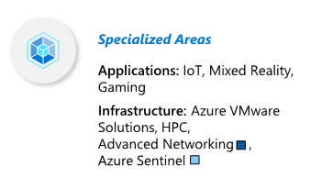
FY21 Azure Priorities, Sales Plays
Applications, Infrastructure, Data, AI

Slide 18







Migrate
WHAT IS IT?
The MIGRATE priority is focused on helping customers to migrate their existing applications to Azure and opptimize to save cost and enable business continuity
MIGRATE Priority OVERVIEW
Key Sales Plays:
Windows & SQL Server Migration
Linux&OSS DB:
SAP On Azure Migration
Windows Virtual Desktop
Hybrid cloud Solution
THE JOURNEY
Awareness
Envision
Validate
Commit
Onboard
Driving top of funnel
Output: Known leads
We are considering to move to the cloud.
Output: New Engagements
What are my cloud options
Output: Defined Milestones
Investigating Architecture
Output: Won Engagements
Deploy and train staff to operate new environment​
Output: ACR
Has our operation improved and what are the next steps​?
Azure Training Days (Always on):
Fundamentals*
Migrating Server Infrastructure
Infrastructure/Server Migration in a Day
AMP for WS/SQL Server migration
Play Activities by Sales Stage
Windows & SQL Server
Assessment Roundtables
Linux & OSS DB
Data Modernization In a Day
AMP for Linux migration
Digital Marketing (GEP),
CEE ECIF Funds
CEE ACO/ECIF Funds
Fast Track
Cloud Economic assessment
AMP for MySQL Database migration
WVD - Windovs Virtual Desktop
Enable Remote Work
WVD In A Day
Cloud Factory
Red Text = Area Executed
Blue Text = Locally Executed
Purple Text = Corp Program
Black Text = CEE Program
Virtual SAP tours, digital promo
SAP on Azure In a Day
SAP on Azure
Webinar Serries
ACO / Azure Credit Offer
Investment Programs
 | Azure Access Industry partner AI solutions TCO Calculator for Apps | Solution Assesments ISV tools (i.e. Cloudlab) Business Viability Assesment | AzAcces Azure Credit Offer ECIF | CAF Workshop Azure Fast Track AMP ACIF Hoster DCM Program Migrate ISV Program
RELEVANT RESOURCES

Slide 19

Innovate
WHAT IS IT?
The INNOVATE priority is focused on helping customers as the build new apps or modernize existing apps as well as for customers looking for a net-new modern cloud Data Warehouse or AI solutions.
INNOVATE Priority OVERVIEW
Key Sales Plays
Artificial Intelligence:/AI (exc. Databricks): AI: Azure Machine Learning, AI: Bots, AI: Cognitive Services, AI: Intelligent Automation/RPA, AI: Knowledge Mining
Analytics (Synapse + Ecosystem): Data Azure: Analytics, Modern Data Warehouse
Databricks: Data: Azure DataBricks
Cloud Native Application Development: Apps: App Innovation (AKS and Container), Apps: App Innovation (App Service, Serverless)
.NET Modernization: Apps: App Modernization (Website/Webapp)
THE JOURNEY
Awareness
Envision
Validate
Commit
Onboard
Driving top of funnel
Output: Known leads
We are considering to move to the cloud.
Output: New Engagements
What are my cloud options
Output: Defined Milestones
Investigating Architecture
Output: Won Engagements
Deploy and train staff to operate new environment​
Output: ACR
Has our operation improved and what are the next steps​?
Modernize .NET Apps with App Service and Azure SQL DB
VT: Modernizing Web Applications and Data
.NET In a Day
AMP for .NET Apps (coming soon)
.NET Modernization Webinar (Nov)
Play Activities by Sales Stage
Cloud Native In a Day
Cloud native app with AI (Cognitive), Kubernetes, CosmosDB/PostgreSQL
Digital Campaign
Cloud Native Virtual Event (Jan)
GBB CosmosDB WKSHP (PL/CZSK)
CEE ACO/ECIF Funds
Fast Track
GBB
CEE ECIF Funds
VT: Modern Data Warehouse
Informatica & PBI on SAP POC/POV
Azure Training Days Modernizing Web Applications Data Intelligent Decision Making Through Modern Data Warehousing
Cloud Factory
Red Text = Area Executed
Blue Text = Locally Executed
Purple Text = Corp Program
Black Text = CEE Program
Analytics
Analytics In a Day
Online Synapse Event (Sept & Feb)
Analytics and AI Accelerate Program
Artificial Intelligence (AI)
AI Virtual Training Day (Q3/Q4) + GBB AML VT
AI In a Day
HackFest
MCS
Investment Programs
CosmosDB Free Trial | Azure Access Industry partner AI solutions TCO Calculator for Apps | CEE Strategic ECIF (for PoC) CEE Azure Access (for PoC) CEE ACO (mitigate onboarding) SAT Assessments | CEE ACO (mitigate onboarding) CEE Strategic ECIF (for PoV) Analytics & AI Accelerate Program (Corp ACO, ECIF etc) | Azure Hybrid Benefit ECIF (for Partner Deployment) Enterprise Dev/Test Pricing SOON! CAF for Kubernetes & AI
RELEVANT RESOURCES

Slide 20
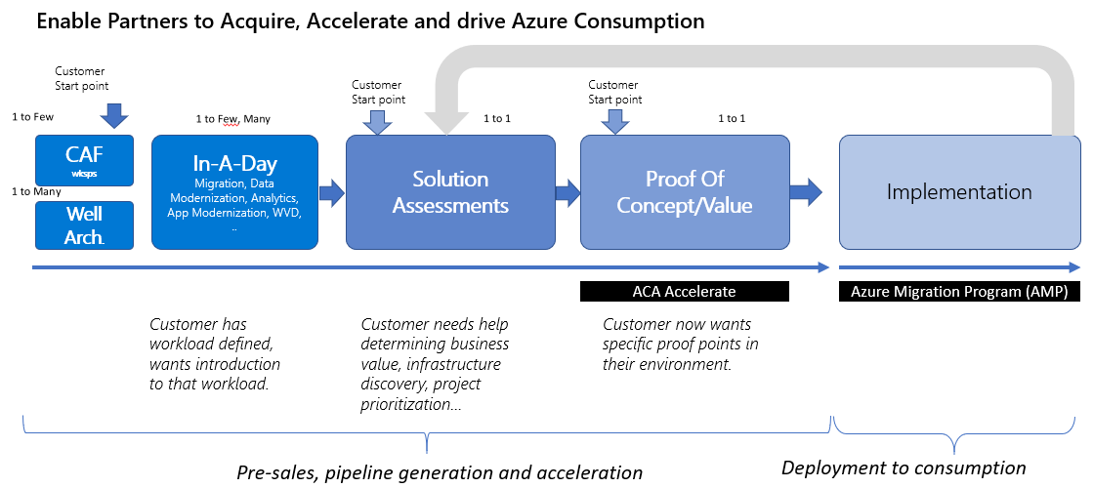

In-A-Day Motion
WHAT IS IT?
A cross segment, pre-sales motion that includes a set of one-day, partner-delivered customer workshops on specific Azure priority scenarios, designed to accelerate the sales process by pulling in partner on earlier stages of the sales cycle and scaling out capabilities of our field.
7 types of In a Day workshops with pre-built presales and lab content for partners to leverage to conduct consistent workshop execution across Azure solution priorities
Pre-packed content for partners to deliver workshops (1:few, 1:many)
Each workshop includes topical scenario-based content, followed by a whiteboard design session, and concluding with hands-on lab(s). Workshops are designed to be delivered digital/in-person.
IN-A-DAY OVERVIEW
Pain points | VM security, compliance, cost. incl Linux | Security, compliance, scale, cost | Remote work, VDI, security, Citrix/VMW | Business insights, time to market, digital transformation | Standard tools/frameworks, time to build models | Microservices, Kubernetes, DevOps w/GitHub | Sustain vs new, adopting, integrating new tech
“In a Day” motion | Server Migration in a Day | Data Modernization in a Day | WVD in a Day | Analytics in a Day | AI in a Day | Cloud Native in a Day | .NET APP Mod in a Day
Persona | IT Pro /TDM | DBA/ TDM | BDM/ CXO | BDM/ CXO | Data Scientist | Dev/TDM | Dev/TDM
Current status | FY21 Q1 | CEE Landed | FY21 Q1 | CEE Landed | CEE Landed | CEE Landed | CEE Landed
Products/ Services | WS, Linux, SQL | SQL DB, SQL IaaS | WVD | Analytics, Synapse, AI, PBI | Azure AI | APS, AKS, OSS DB, AI, DevOps, Cosmos DB | APS, AKS, SQL DB, AI
Partner TTT Links | Coming soon | DMIAD TTT Resources | Coming soon | Analytics in a Day TTT Resources | AI in a Day TTT Resources | Cloud Native in a Day TTT Resources | .NET Modernization in a Day partner TTT resources
Priority | MIGRATE | MIGRATE | MIGRATE | INNOVATE | INNOVATE | INNOVATE | INNOVATE

Slide 21
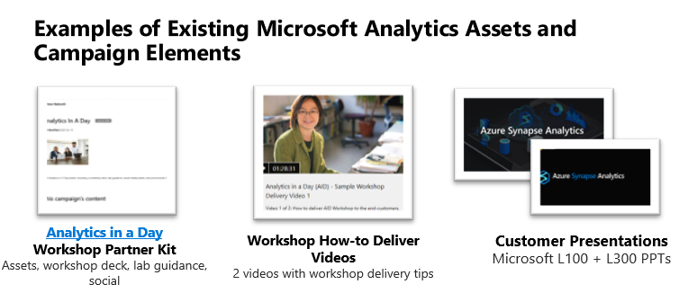
In-A-Day Motion / example: Analytics in a Day
Event description
A one-day, hands-on workshop covering everything from data ingestion to business intelligence. In our workshop, data professionals will better understand how to: Streamline cloud analytics pipelines Build a scalable modern data warehouse Ensure flexibility with business needs The last few hours of the workshop will be dedicated to hands-on training to help get you started on your cloud analytics journey. Labs will focus on building a modern data warehouse with Azure Synapse Analytics, Azure Databricks, and Power BI. Analytics in a day is designed to simplify and accelerate your journey towards using a modern data warehouse to power your business. In our workshop, you will better understand how to: Create an analytics pipeline that goes from data ingestion to insights using Power BI Empower self-service analytics Enable a truly data-driven culture in your business The last few hours of the workshop will be dedicated to hands-on training to help get you started on your cloud analytics journey. For virtual sessions, suggestion is to do up to 4h virtual delivery depending on if the partner is demoing the lab or providing access to the participants to test the labs during the call (shorter version)
Target audience
Target Audience Roles: All Data Professionals Format 1:few – 20 attendees per event
Solution area(s) alignment
Data and AI Modern Workplace (Power BI) Business Apps (Customer Insights)
Subsidiary alignment
Driving more ADS consumption Power BI, SQL Server and Azure usage and adoption
KPIs
# of attendees CSAT per event # of opportunities #leads generated
Resources
Updated Analytics in a day V2 content and labs
Business objectives
This is a partner driven workshop intended to provide customers with an end-to-end view of the Azure Analytics Platform. The main goal is to deliver the workshop to customers in Major and Corporate segments to accelerate existing Modern Datawarehouse Engagements. As a secondary goal it can be used to develop new pipe.
Follow up
Partner identifying progress in existing engagements and/or generating new engagements with customers, and uploading them as qualified leads in Partner Center/Partner Sales Connect

Slide 22
Learning options for you
Description
Microsoft Baseline Events – local (digital) aimed at giving introductory information about the Azure portfolio.
Azure Training Days (Migrate):
Azure Fundamentals
Migrating Server Infrastructure
Azure Training Days (Innovate)
Modernizing Web Applications Data
Intelligent Decision Making Through Modern Data Warehousing
Digital Hybrid Learning Workshops - through Learning Partners to close the MCP gap, with focus on prioritized advanced certifications
Exam Preparation sessions – (local) limited space organized by local enablement leads. Stay tuned on the regular forums where your local team promotes partner skilling events.
VILT (Virtual Instructor Led Courses) – Corp driven Online training offerings to be found on partner.Microsoft.com. (Link)
Technical 1-1 engagements (solution development/ practice building)
Unmanaged partners – Engage PTC community through “Technical Presales and Deployment services” (Link)
Managed Partners – request Architect support through your Partner Development Manager.
CSP partner Ecosystem Enablement – Technical and Sales readiness (TTT) for CEE Distis towards resellers focused on advanced scenarios (WVD, Migrate OS, Hybrid Cloud, Analytics & AI, Dev Ops).
Sales/Marketing - In a Day TTT content/sales plays (Slide In a Day wkps – links)

Slide 23
Access presentation & recording at aka.ms/AA8t54z Subscribe to our newsletter: aka.ms/AA8t56p

Slide 24
Thank you for your attention!

